Slide 1
Building Buy In
Amanda Norton, MSW
Improvement Advisor

Slide 2
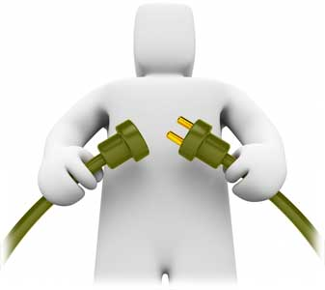
The Pathway to a New System
You are here

Slide 3
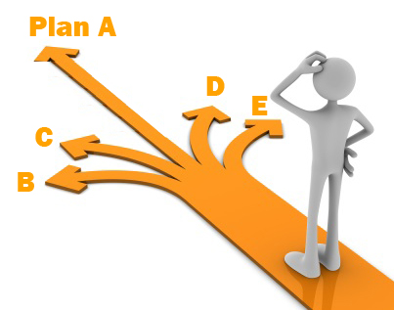

Slide 4
Why “Scale Up” Improvement
Decide if one or more changes will lead to the desired improvement
What combination achieves this improvement
How much improvement can we expect
Determine how this will work in the real world
Social implications

Slide 5
Scale-up: Breaking the Learning Barriers
Intentional Transitions | Barrier | Method
0-1 | Conference room enthusiasm/necessary but not sufficient | Test under most favorable conditions
1-5 | Get lucky Unique circumstance | Develop and test a process
5-25 | Depend on a hero | Test the process with a variety of people and conditions
25-125 | Brute force/high intensity | Create demand with a system and then service the demand
125-625 | Reliance on 1-1 contact | Create demand and then use the spread model

Slide 6
Failed Tests…Now What?
Reasons for failed tests:
1. Change not executed well
2. Support processes inadequate
3. Hypothesis/hunch wrong:
Change executed but did not result in local improvement
Local improvement did not impact global measures
Collect data during the Do step of the Cycle to help differentiate these situations
Notes:
When we talk about a successful test, we mean one that enables the team to draw conclusions (learning) about the changes needed to reach its goal. There are a number of reasons for failed tests that the team should consider during the Do and Study phases of the cycle:
1. The test may have been planned well, but everyone did not carry out their assigned tasks.
2. Support processes such as data collection were inadequate so the full impact of the test could not be evaluated.
3. The prediction that was made during the Plan phase of the cycle was not upheld. In other words, the hypothesis about what was expected to happen as a result of the change did not occur. Such a test is often a powerful learning experience for the team, one that can lead to new insight about what the next tests should be.
It’s important to know which of these reasons contributed to the failure of the test since the team doesn’t want to draw conclusions about a change if it wasn’t carried out well or if the support processes weren’t in place to fully evaluate its impact. If the test wasn’t carried out well, but the team still has confidence that the change is a good one, the team can repeat the test.

Slide 7
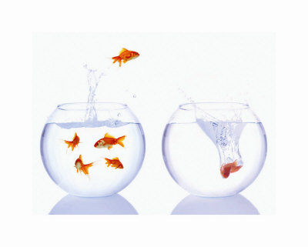
From Adapting to Adopting
When your predictions are consistently accurate
When you have successfully tested under all relevant conditions
When motivation is high
When measures are moving in the direction of improvement
Plan
Study
Act
Do

Slide 8
Moving from Developing, to Testing, to Implementing a Change

Slide 9
Moving from Developing, to Testing, to Implementing a Change

Slide 10
Adoption of Ideas
“The part of the diffusion curve from about 10 percent to 20 percent adoption is the heart of the diffusion process. After that point, it is often impossible to stop the further diffusion of a new idea, even if one wished to do so.”
E.M. Rogers, Diffusion of Innovations (1995
34%
34%
13.5%
16%
2.5%
Early
Adopters
Early
Majority
Late
Majority
Innovators
Laggards

Slide 11
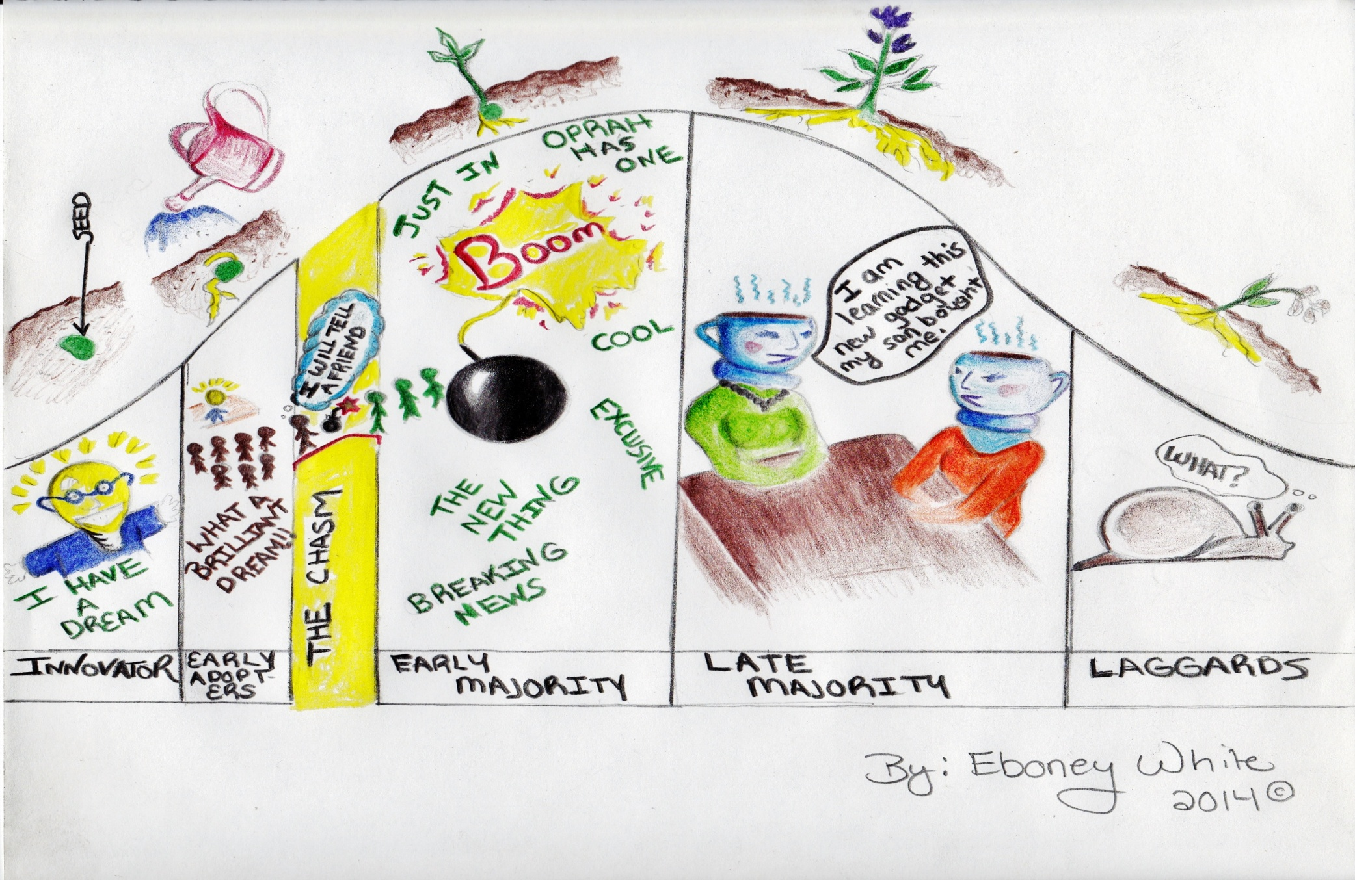

Slide 12
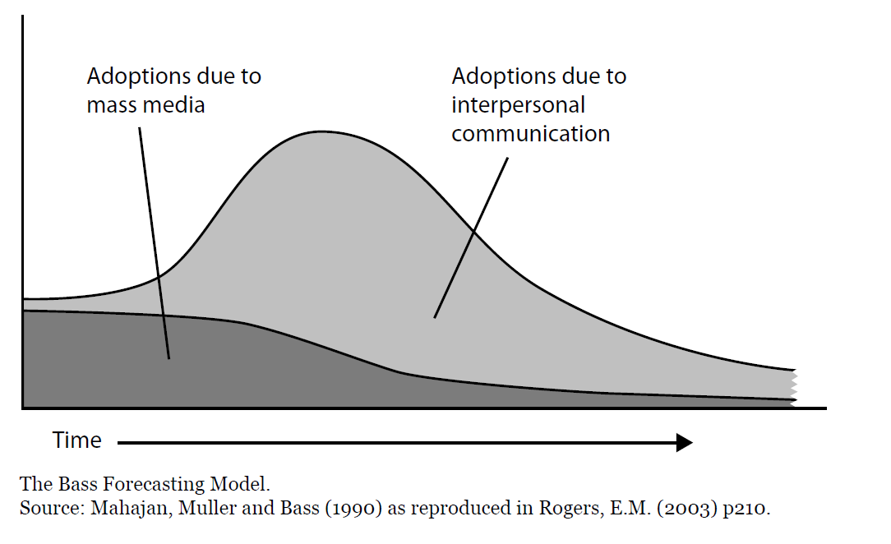

Slide 13
Ways to Communicate
SHARE
INFORMATION
SHAPE
BEHAVIOUR
General
Publications
flyers
newsletters
videos
articles
posters
Personal
Touch
letters
cards
postcards
Interactive
Activities
telephone
email
visits
seminars
learning sets
modeling
Public
Events
Road shows
Fairs
Conferences
Exhibitions
Mass meetings
Face-to-face
one-to-one
mentoring
seconding
shadowing
(C) 2001, Sarah W. Fraser
Adapted from Ashkenas, 1995
Notes:
-ones to right make them actually chg behaviors (collaboration fit here) people don’t chg behavior based on newsletters

Slide 14
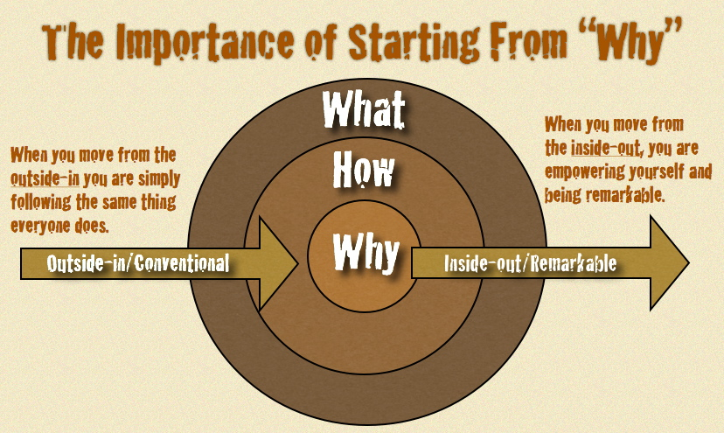
“People don’t buy what you do, they buy why you do it.” -Simon Sinek
“How Great Leaders Inspire Action” – Simon Sinek

Slide 15
Roger’s Attributes of the Change that Affect the Rate of Adoption
Relative Advantage
How improved an innovation is over the previous way of doing things.
Simplicity
If the innovation is perceived as complicated or difficult to use, an individual is unlikely to adopt it.
Compatibility
The degree to which an innovation is perceived as being consistent with the values and needs of the potential adopters
Notes:
3
-Want you to take your change and evaluate it based on these 5 attributes
-all from decision makers point of view (if Dr. be nice if always how is for pt- reality for all of us is what it will mean for ME)
-compatibility—hard—chronic care requires Dr. to make pt they didn’t see- haven’t for 6 mo the priority rather than the person we gave great care to today—big value dif
-compatibility-cell hone-would we adopt if could only call other cell phones
-testability-car-ask for test drive, salesman says, sorry, you either buy it or not! What would you think of that. Care plan-I’d like to test it out
Observability-visits, use data to observe change

Slide 16
Roger’s Attributes of the Change that Affect the Rate of Adoption
Trialability
How easily an innovation may be experimented. If a user is able to test an innovation, the individual will be more likely to adopt it.
Observability
The extent that an innovation is visible to others.
Notes:
3
-Want you to take your change and evaluate it based on these 5 attributes
-all from decision makers point of view (if Dr. be nice if always how is for pt- reality for all of us is what it will mean for ME)
-compatibility—hard—chronic care requires Dr. to make pt they didn’t see- haven’t for 6 mo the priority rather than the person we gave great care to today—big value dif
-compatibility-cell hone-would we adopt if could only call other cell phones
-testability-car-ask for test drive, salesman says, sorry, you either buy it or not! What would you think of that. Care plan-I’d like to test it out
Observability-visits, use data to observe change

Slide 17
Staff and Clinic
Relative Advantage
Simplicity
Compatibility
Trialability
Observability
Patients and Families

Slide 18
One common question
Perceived Value
Patient
Leaders
Community
(potential future consumers)
Staff
http://www.insidetwocircles.com/2013/10/10/whatsinitforme/

Slide 19
Building Perceived Value
Change behavior
Change their lifestyle
Change their job duties
Commit to new routines
Deal with past relationships
Have new conversations with providers/partners
Spread the news
WHY SHOULD THEY…

Slide 20
What might it look like
Patients
Participation
Behavior Change
Community
News/Media Coverage
Referrals/Enrollment
Leaders
Resourcing
Regularly review project impact
Spread the News
Partners
Annual report
Referrals
Sharing information w/ consumers
Attending stakeholder meetings
Future Funding

Slide 21
Pain
Gain
Inertia
Default = Do nothing
Alternatives
Good Enough
Risk of Trying
http://www.forbes.com/sites/michaelskok/2013/06/14/4-steps-to-building-a-compelling-value-proposition/

Slide 22
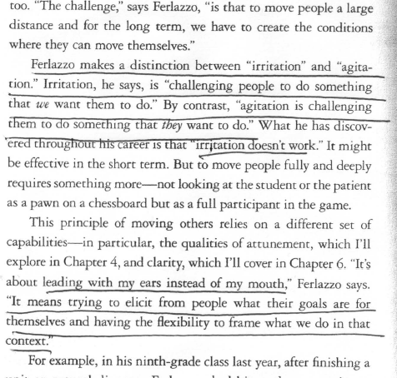
To Sell Is Human by Daniel Pink © 2012 Riverhead Books

Slide 23
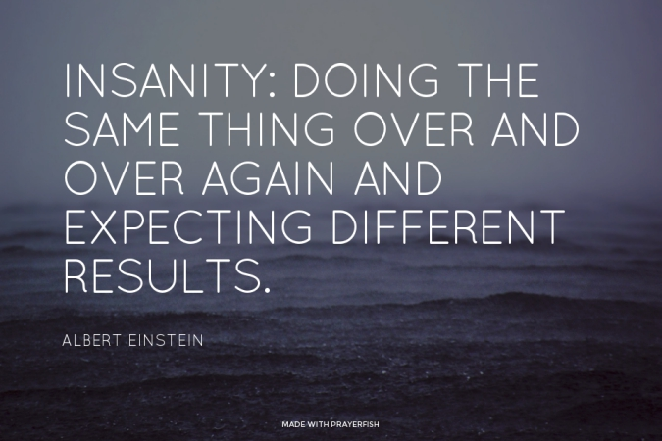
Questions

